Slide 1
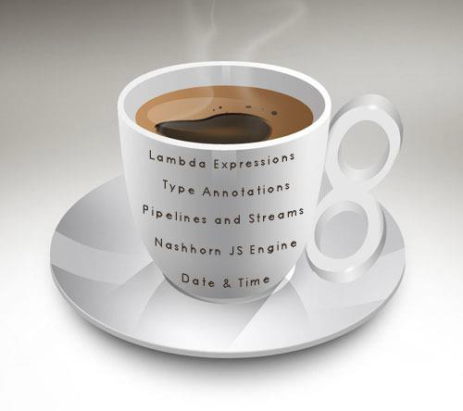
Java 8
By
Shalini Mittal

Slide 2

The journey to begin today…
Progress of Java Versions
Why Java 8
Java 8 Installation
IDE support for java 8
Java 8 Features Overview
Lambda Expressions
Functional Interfaces

Slide 3
Progress So Far…..
Version Name | Code Name | Release Date
JDK 1.0 | Oak | January 1996
JDK 1.1 | (none) | February 1997
J2SE 1.2 | Playground | December 1998
J2SE 1.3 | Kestrel | May 2000
J2SE 1.4 | Merlin | February 2002
J2SE 5.0 | Tiger | September 2004
Java SE 6 | Mustang | December 2006
Java SE 7 | Dolphin | July 2011
Java SE 8 | (Not available) | March 2014
Version History
Notes:
.63 9.36

Slide 4

Java 8
Flexibility and Reusability
Convenience to write
Faster and more memory efficient code
Immutability
Easier Parallelization and Lazy Evaluation
Cleaner more concise code
Optimization
Improve Performance
Notes:
The benefits of lazy evaluation include:
Performance increases by avoiding needless calculations, and error conditions in evaluating compound expressions
The ability to construct potentially infinite data structures
The ability to define control flow (structures) as abstractions instead of primitives
Like construct an object on a condition only if reqd if its heavy
Short ckt operator
etx

Slide 5
Java 8 Installation
Download JAVA SE 8
http://www.oracle.com/technetwork/java/javase/downloads/index.htmlJDK 1.8 itself
Online API
– http://docs.oracle.com/javase/8/docs/api/
Java Se 8 released on March 2014

Slide 6
Java 8 IDE Installation
Download Eclipse IDE
Eclipse Luna supports java 8
Alternatively eclipse Kepler can be configured for java 8.
http://www.eclipse.org/downloads/java8/
NetBeans
NetBeans 8 and later
https://netbeans.org/downloads/
https://netbeans.org/kb/docs/java/javase-jdk8.html
IntelliJ IDEA
IDEA 13.1 and later
http://www.jetbrains.com/idea/

Slide 7

Lets Explore Java 8
What is Java????
Java Object Oriented Language (Noun centric)
Need
Functional Programming (Verb Centric)
Closures
Solution In Java
Lambda Expressions
Notes:
C++ C# introduced lambda
Functional programming javascript
Closures a need soln lambda

Slide 8
The problem we faced …
Only Object-oriented language.
Functions don’t exist by itself
Method as argument cannot be passed
Method body cannot be returned

Slide 9
Pre - Lambda Expressions
Separate class
Arrays.sort(theArray, new SeparateClass(…));
Main class (which implements interface)
Arrays.sort(theArray, this);
Named inner class
Arrays.sort(theArray, new InnerClass(…));
Anonymous inner class
Arrays.sort(theArray, new Comparator<String>() { … });

Slide 10

So here is the solution - Lambda Expressions?
An anonymous function
Plain methods / functionalities can be passed as arguments
A method without a declaration, i.e., access modifier, return value declaration, and name
A shorthand for method definition
Methods exist without the need of containing class
Bounded to object type known as Functional Interface.
Notes:
Shorthand that allows you to write a method whose method definition is short in the same place you are going to use it.
It saves you the effort of declaring and writing a separate method to the containing class.
In Java, the lambda expressions are represented as objects, and so they must be bound to a particular object type known as a Functional Interface.

Slide 11
Holla!! Wait Functional Interface
Called SAM(Single Abstract Method)
Can have only 1 abstract method declared in their definition
It can have more than 1 default or static methods (more to it later)
Annotated with @FunctionalInterface for the compiler level errors
@FunctionalInterface
public interface SimpleFuncInterface {
public void doWork();
}
These can be represented using Lambda expressions, Method reference and constructor references
Interface summary
Notes:
Marker Interface

Slide 12
Structure Of Lambda Expressions
(Argument List) Arrow Token {Body }
(type argument, ….) –> { java statements; }
Example Lambda Expressions
() -> { System.out.println("Hello World!");}
(int a, int b) -> a + b
() -> { return 1; }
(String name) -> { System.out.println("Hello "+name); }
n -> n % 2 != 0

Slide 13
Lambda Expressions Key Notes
A lambda expression can have zero, one or more parameters.
Parameters are enclosed in parentheses and separated by commas. e.g. (a, b) or (int a, int b)
Empty parentheses are used to represent an empty set of parameters. e.g. () -> 42
When there is a single parameter, if its type is inferred, it is not mandatory to use parentheses. e.g. a -> return a*a
If body of lambda expression has single statement curly brackets are not mandatory and the return type of the anonymous function is the same as that of the body expression.
When there is more than one statement in body than these must be enclosed in curly brackets (a code block) and the return type of the anonymous function is the same as the type of the value returned within the code block, or void if nothing is returned

Slide 14
Examples Of Lambda Expressions
//Old way:
new Thread(new Runnable() {
@Override
public void run() {
System.out.println("Hello from thread");
}
}).start();
//New way:
new Thread(
() -> System.out.println("Hello from thread")
).start();

Slide 15
Examples Of Lambda Expressions Contd
//Old Way:
button.addActionListener(new ActionListener() {
@Override
public void actionPerformed(ActionEvent e) {
System.out.println("The button was clicked using old fashion code!");
}
});
//New way:
button.addActionListener( (e) -> {
System.out.println("The button was clicked. From lambda expressions !");
});

Slide 16
Difference between Lambda and Anonymous class
One key difference between using Anonymous class and Lambda expression is the use of this keyword.
For anonymous class ‘this’ keyword resolves to anonymous class, whereas for lambda expression ‘this’ keyword resolves to enclosing class where lambda is written.
Another difference between lambda expression and anonymous class is in the way these two are compiled.
Java compiler compiles lambda expressions and convert them into private method of the class.
It uses invokedynamic instruction that was added in Java 7 to bind this method dynamically

Slide 17
Built-In Functional Interfaces
Predicate<T> - A predicate is a statement that may be true or false depending on the values of its variables. It can be thought of as a function that returns a value that is either true or false.
Consumer<T> - This functional interface represents an operation that accepts a single input argument and returns no result.
Function<T,R> - This functional interface represents a function that accepts one argument and produces a result. One use, for example, it's to convert or transform from one object to another
Supplier<T> - This functional interface does the opposite of the Consumer, it takes no arguments but it returns some value. It may return different values when it is being called more than once.

Slide 18
Primitive versions of functional interfaces
Due to the way generics are implemented, parameters of the functional interfaces (for example, Predicate<T>) can be bound only to reference types (like String, objects, etc).
If you want to use primitive types with these functional interfaces, Java uses a mechanism called autoboxing to automatically convert a primitive to its corresponding wrapper type (for example, int to Integer) and vice versa.
But since boxed values use more memory, this comes with a performance cost. For this reason, Java provides specialized versions of the functional interfaces to avoid autoboxing operations when the inputs or outputs are primitives
For example, instead of using
Predicate<Integer> p = i -> i > 10;
You can use
IntPredicate p = i -> i > 10;

Slide 19
Binary versions of functional interfaces
versions of interfaces like Predicate<T>, Consumer<T>, Function<T,R>, UnaryOperator<T> that take two arguments called Binary versions
Note there is no binary version of Supplier. This is because a Supplier takes no arguments.

Slide 20

Any Question ?

Slide 21
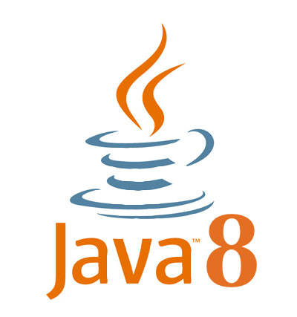
Thank you !

